Slide 1

INTRODUCTION TO GREAT DESIGN
WORKSHOP STARTS 9.30AM

Slide 2

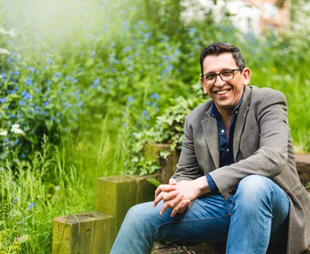
HELLO FROM ME…
20 year information design career
Training researchers since 2015
Honorary Fellow in Sci Comms at UEA
Pint of Science coordinator
Lego Serious Play facilitator
Cryptic crossword setter

Slide 3
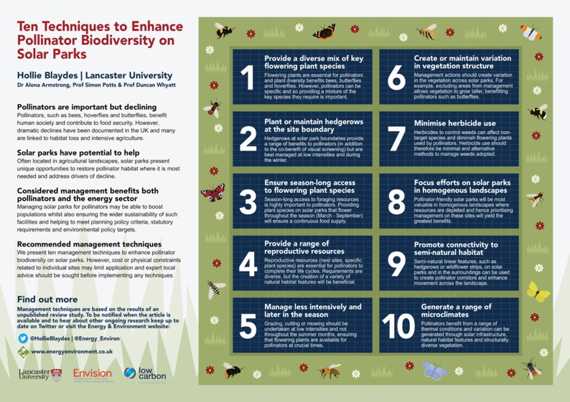

Slide 4
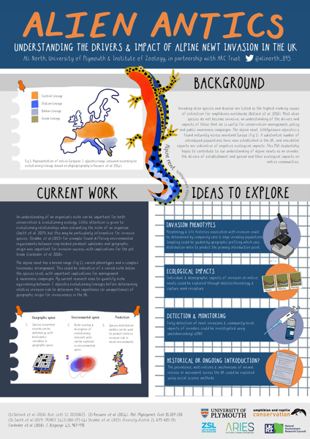

Slide 5
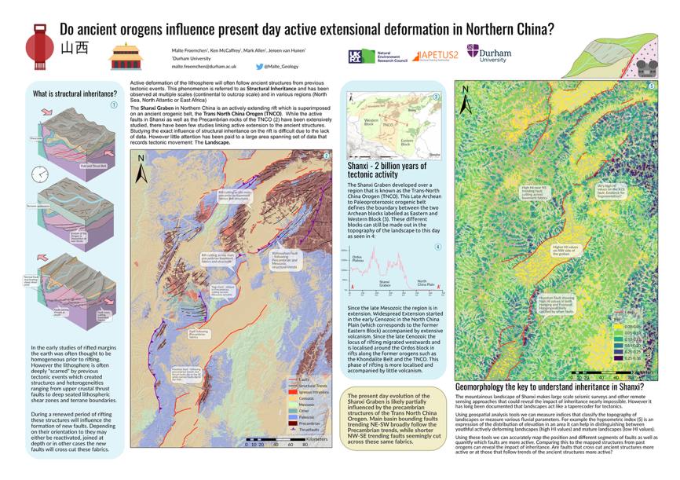

Slide 6
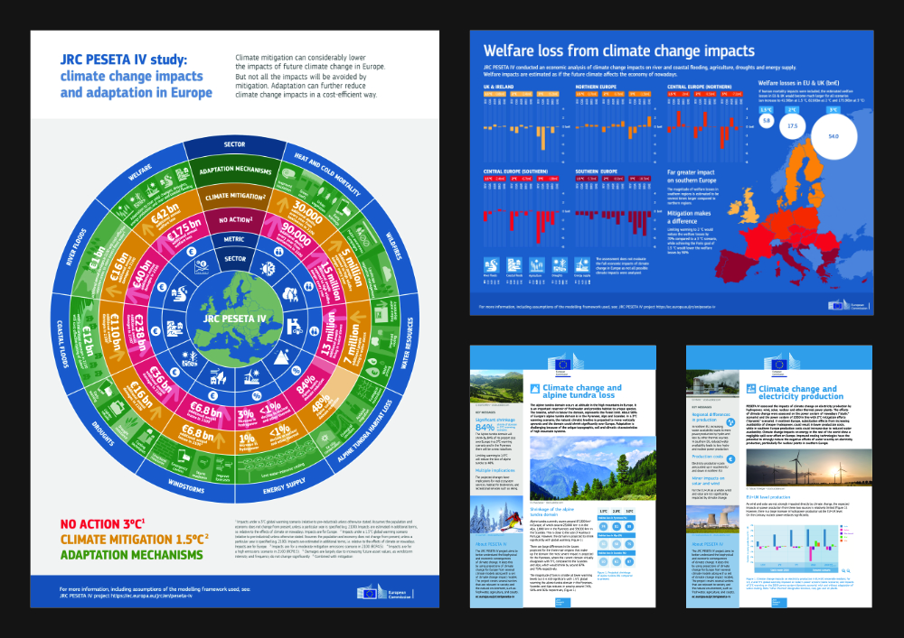

Slide 7
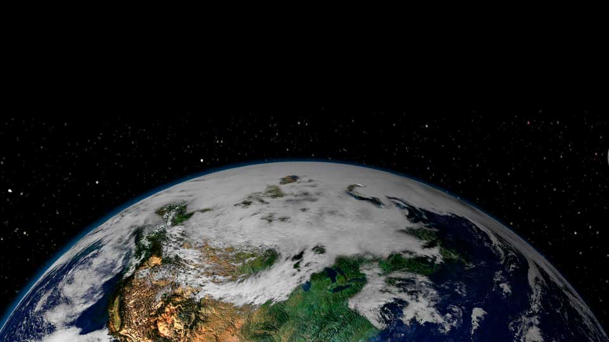

OUR MISSION…
TO SAVE THE WORLD
(SERIOUSLY)
BETTER SCI COMMS MEANS
BETTER KNOWLEDGE EXCHANGE,
BETTER IMPACT AND BETTER ENGAGEMENT

Slide 8
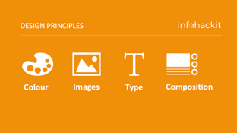
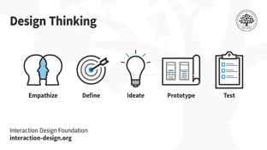
TODAY’S SESSION
DESIGN PRINCIPLES
Technical grounding in colours, images, type and composition and tips along the way
PLANNING
Prototyping an infographic project
using pen and paper and design thinking

Slide 9

YOU HAVE AN EYE FOR DESIGN

Slide 10

YOU HAVE A NATURAL TALENT

Slide 11
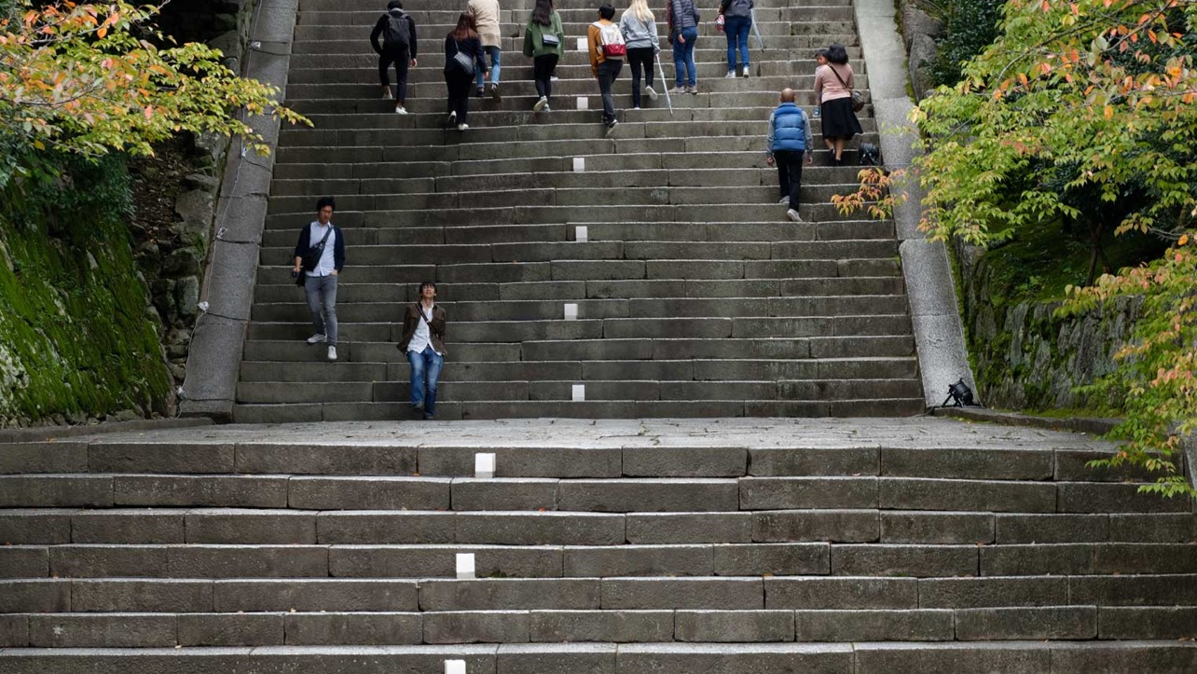
ANYONE CAN IMPROVE
FUNCTION
AESTHETIC

Slide 12
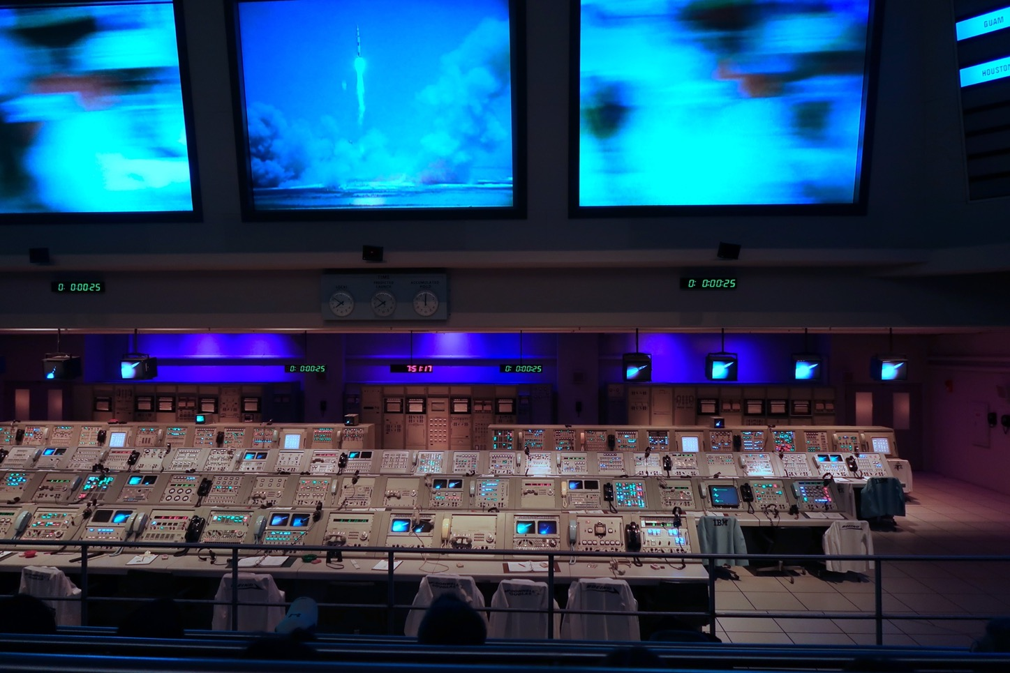
YOU ARE IN CONTROL AND
MAKING GOOD DECISIONS

Slide 13




DESIGN PRINCIPLES
Colour
Images
Type
Composition

Slide 14
DESIGN PRINCIPLES
Colour
Images
Type
Composition

Slide 15
DESIGN PRINCIPLES: COLOUR
COLOUR SYSTEMS
RGB & CMYK

Slide 16
DESIGN PRINCIPLES: COLOUR
RGB
Values 0-255
Same as HEX
More colours
Brighter
FOR SCREEN
CMYK
Values 0-100
For PRINT

Slide 17
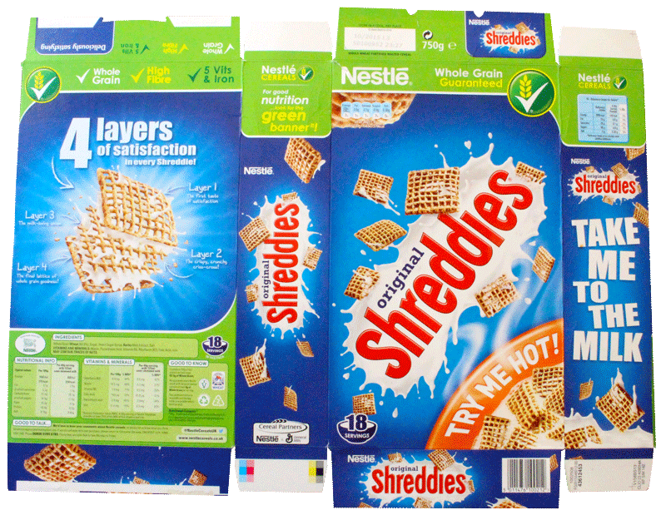
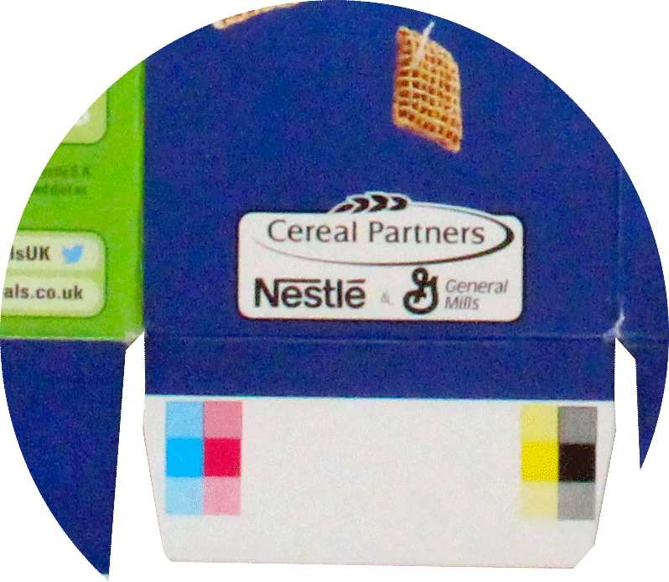
DESIGN PRINCIPLES: COLOUR
C
M
Y
K

Slide 18
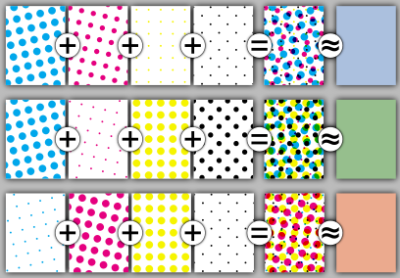
DESIGN PRINCIPLES: COLOUR

Slide 19
DESIGN PRINCIPLES: COLOUR
C = 0 M = 70 Y = 100 K = 0
C = 70 M = 0 Y = 100 K = 0
C = 70 M = 100 Y = 0 K = 0
C = 100 M = 0 Y = 70 K = 0

Slide 20

How to choose a great colour scheme

Slide 21
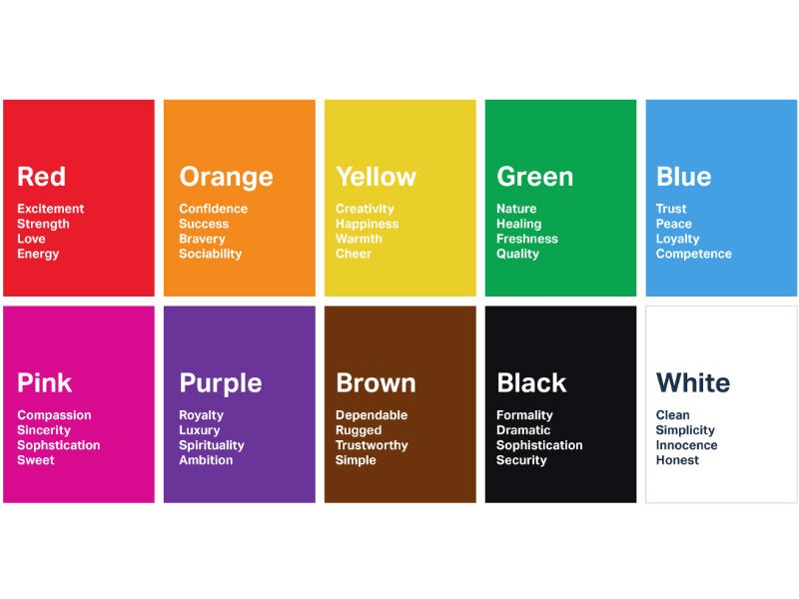

Slide 22


Slide 23
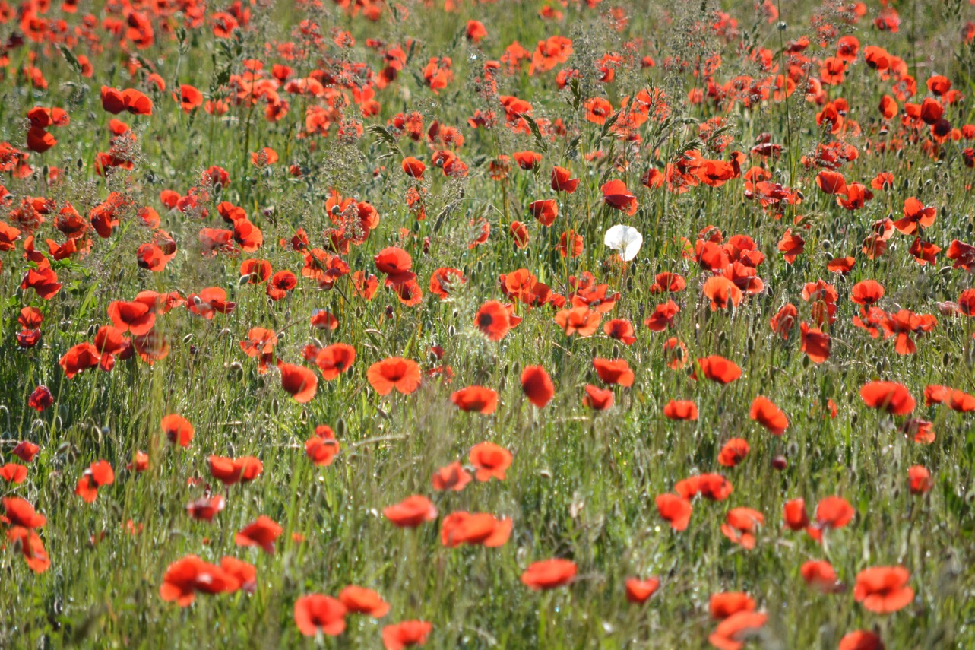

Slide 24
Love looks not with the eyes, but with the mind, And therefore is winged Cupid painted blind.
Love looks not with the eyes, but with the mind, And therefore is winged Cupid painted blind.
Love looks not with the eyes, but with the mind, And therefore is winged Cupid painted blind.
12.26:1
4.71:1
1.04:1

Slide 25
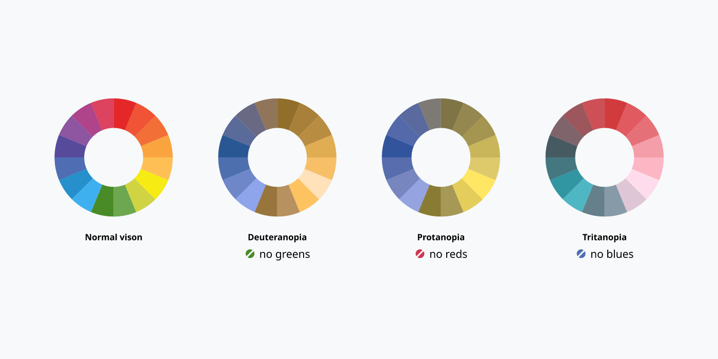

Slide 26
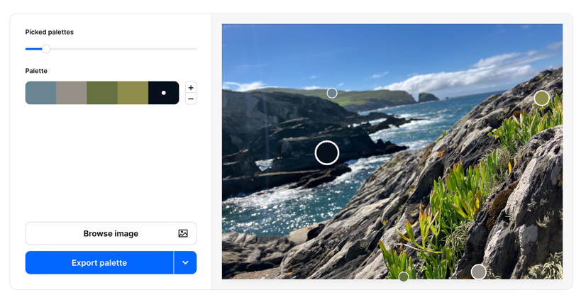

DESIGN PRINCIPLES: COLOUR
COOLERS

Slide 27
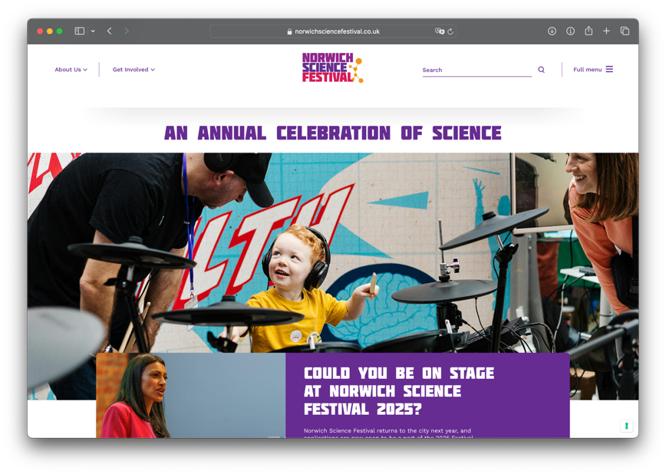

DESIGN PRINCIPLES: COLOUR

Slide 28
DESIGN PRINCIPLES
Colour
Images
Type
Composition

Slide 29
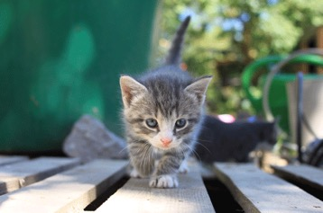
DESIGN PRINCIPLES: IMAGES
WHAT IS A RASTER?

Slide 30
DESIGN PRINCIPLES: IMAGES
WHAT IS A VECTOR?

Slide 31

DESIGN PRINCIPLES: IMAGES

Slide 32


DESIGN PRINCIPLES: IMAGES
RASTER
.jpg
.tif
RASTER
(transparency)
.gif
.png
VECTOR
.afdesign .ai
.eps .svg
.pdf
RASTER FILES CAN BE USED IN VECTOR FILES
VECTOR FILES CANNOT BE USED IN RASTER FILES

Slide 33
DESIGN PRINCIPLES: IMAGES
RESOLUTION
HOW DO WE
MEASURE IT?

Slide 34
DESIGN PRINCIPLES: IMAGES
300dpi (print)
72dpi (screen)

Slide 35
DESIGN PRINCIPLES: IMAGES
WILL IT LOOK OK?
☐ RESOLUTION (DPI)
☐ SIZE OF IMAGE
☐ SCALE OF IMAGE
☐ EFFECTIVE RESOLUTION (EDPI)
☐ HOW CLOSE ARE PEOPLE GOING TO BE?
☐ QUALITY OF IMAGE
IF IN DOUBT..
TEST IT!

Slide 36

DESIGN PRINCIPLES: IMAGES

Slide 37

DESIGN PRINCIPLES: IMAGES

Slide 38
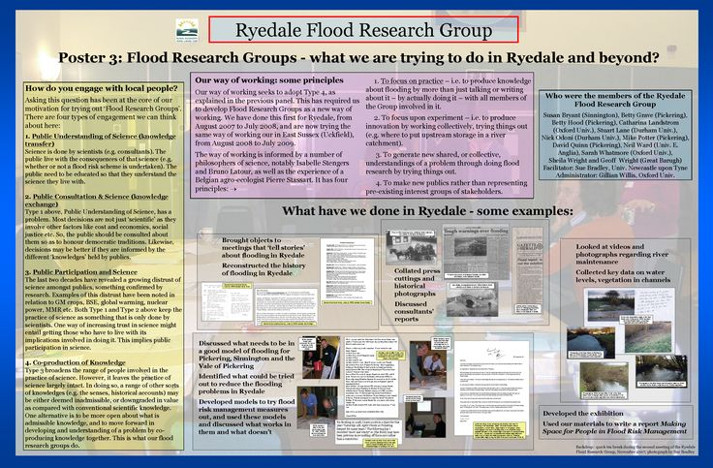

Slide 39
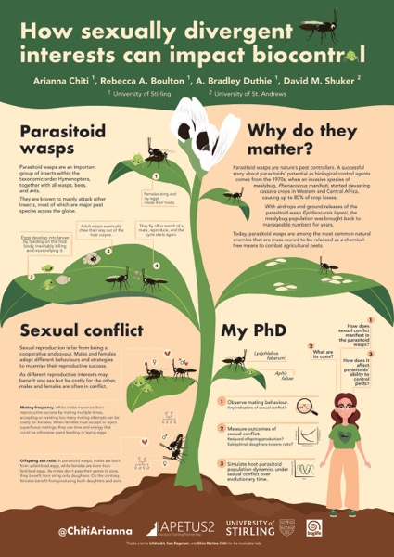

Slide 40
DESIGN PRINCIPLES
Colour
Images
Type
Composition

Slide 41
DESIGN PRINCIPLES: TYPE
SERIF & SANS SERIF
Aa
Aa
Times
Arial

Slide 42
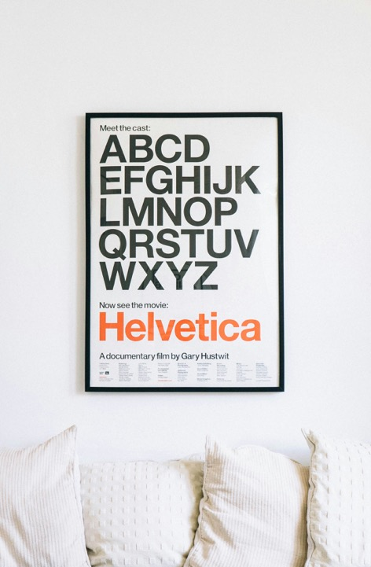
DESIGN PRINCIPLES: TYPE
< HELVETICA
< ARIAL

Slide 43
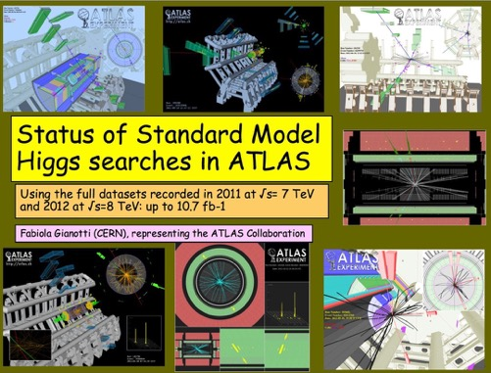
DESIGN PRINCIPLES: TYPE
< COMIC SANS

Slide 44
DESIGN PRINCIPLES: TYPE
FACTORS OF LEGIBILITY
AA
AA
AA
FONT
CONTRAST
SIZE

Slide 45
DESIGN PRINCIPLES: TYPE
FACTORS OF LEGIBILITY
AA
SIZE
WORD COUNT
SIZE OF POSTER
NUMBER OF POSTERS
LENGTH OF SESSION

Slide 46
DESIGN PRINCIPLES: TYPE
FONT FAMILIES
Arial Regular Arial Italic
Arial Bold Arial Bold Italic
Arial Black Arial Narrow Bold

Slide 47
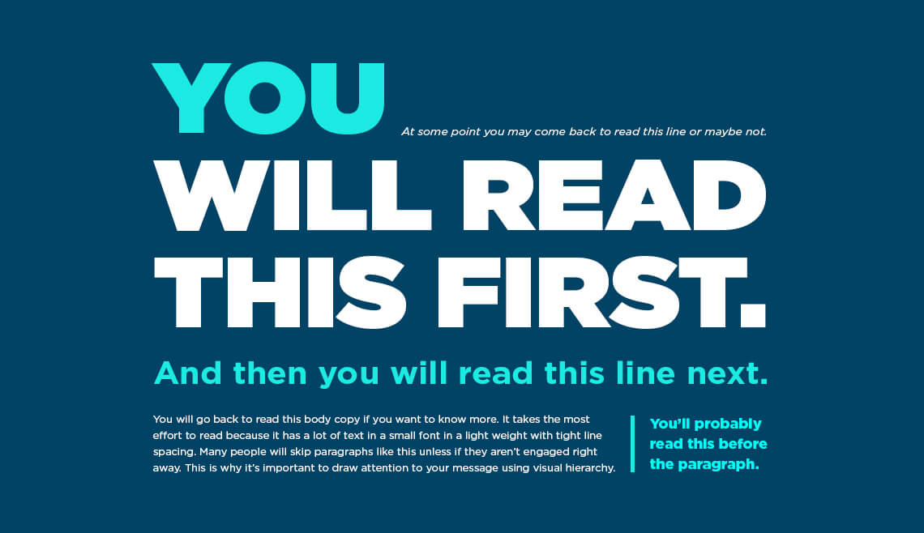
© Appleton Creative

Slide 48
DESIGN PRINCIPLES: TYPE
TYPESETTING
A
B
C

Slide 49
DESIGN PRINCIPLES: TYPE
A
B

Slide 50
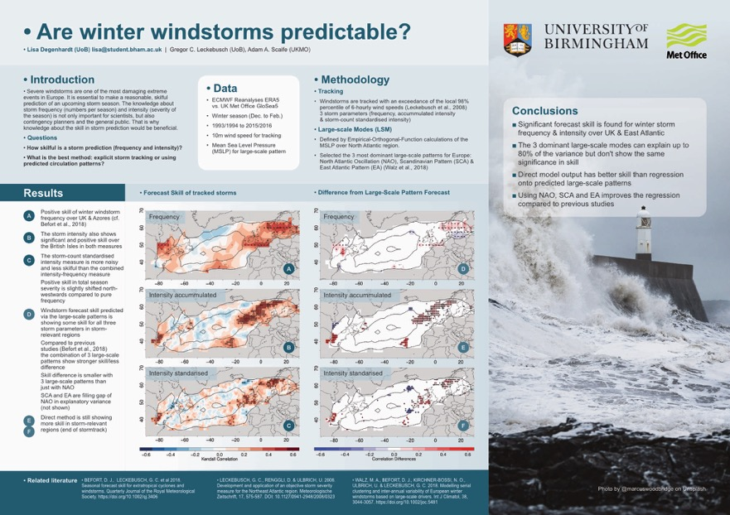


Slide 51
DESIGN PRINCIPLES
Colour
Images
Type
Composition

Slide 52
YOU ARE IN CONTROL AND
MAKING GOOD DECISIONS

Slide 53
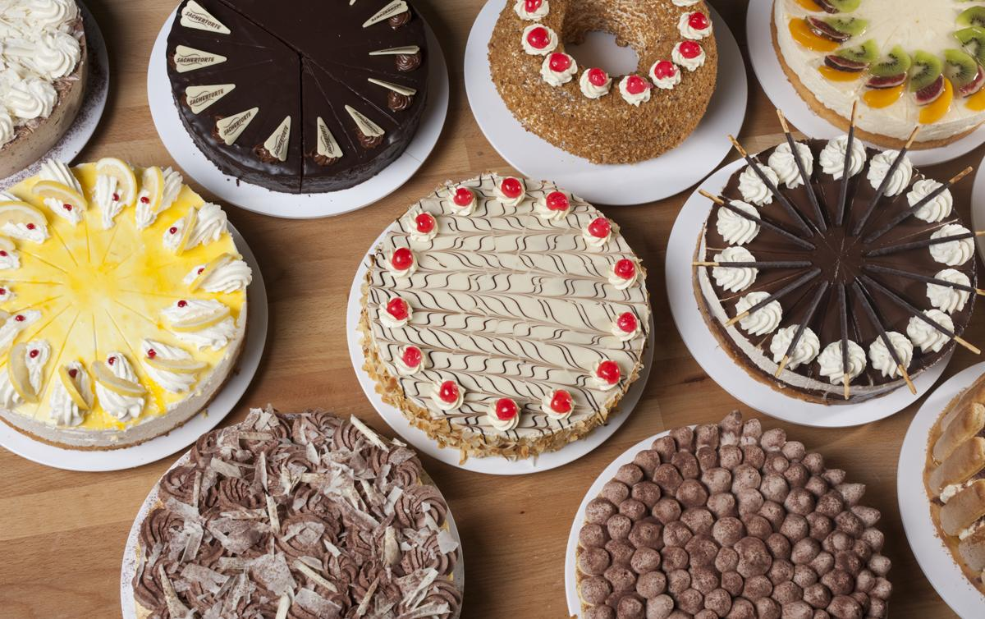
WHAT IS
THE “BEST” DESIGN?

Slide 54


THERE ARE NO
SILVER BULLETS

Slide 55

LOOK AROUND YOU

Slide 56
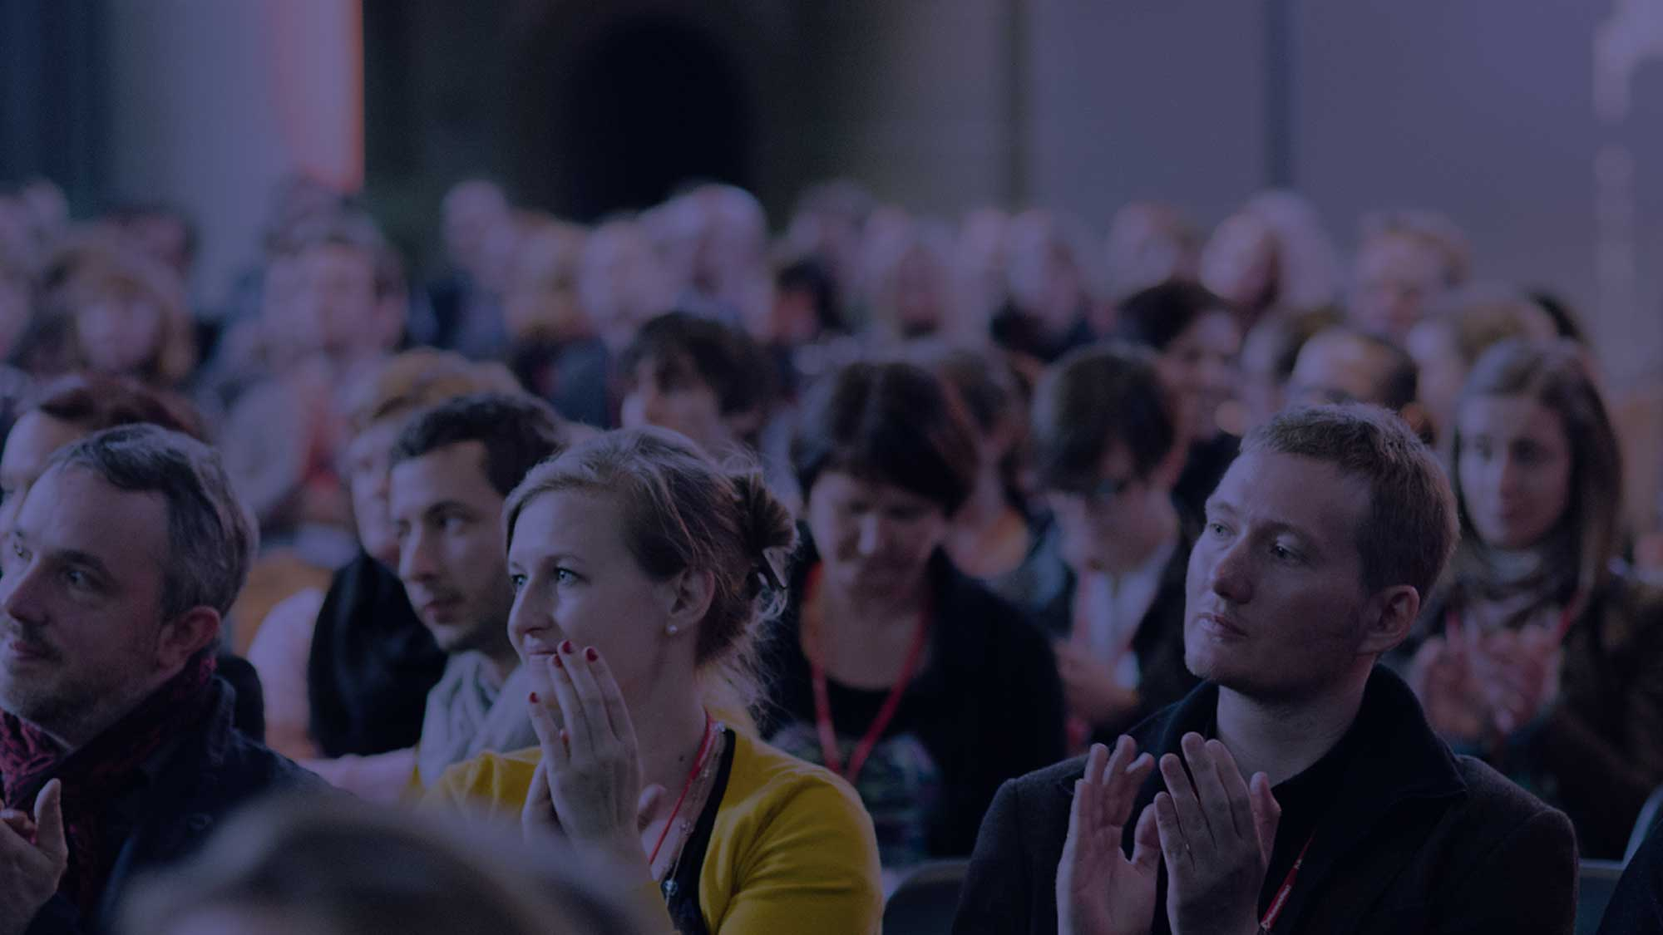
DEFINE YOUR AUDIENCE
& HOW WILL YOU REACH THEM?

Slide 57
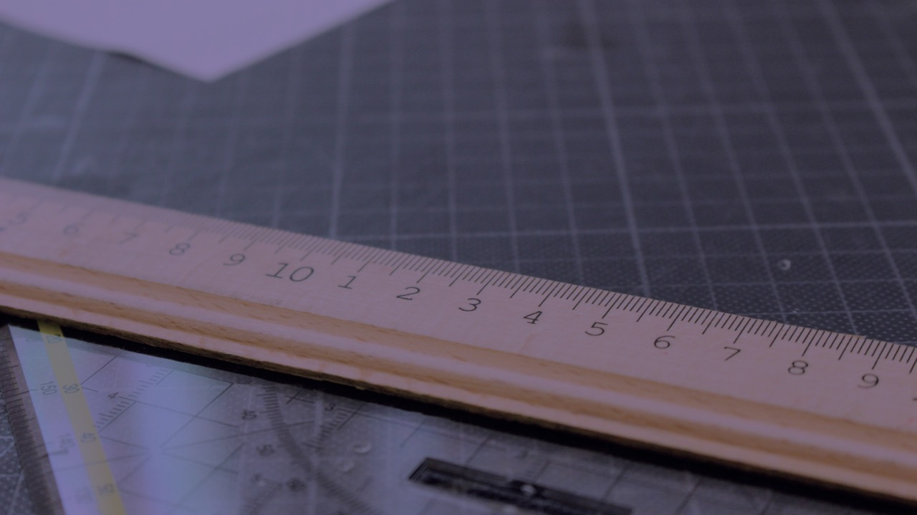
DEFINE YOUR PARAMETERS

Slide 58
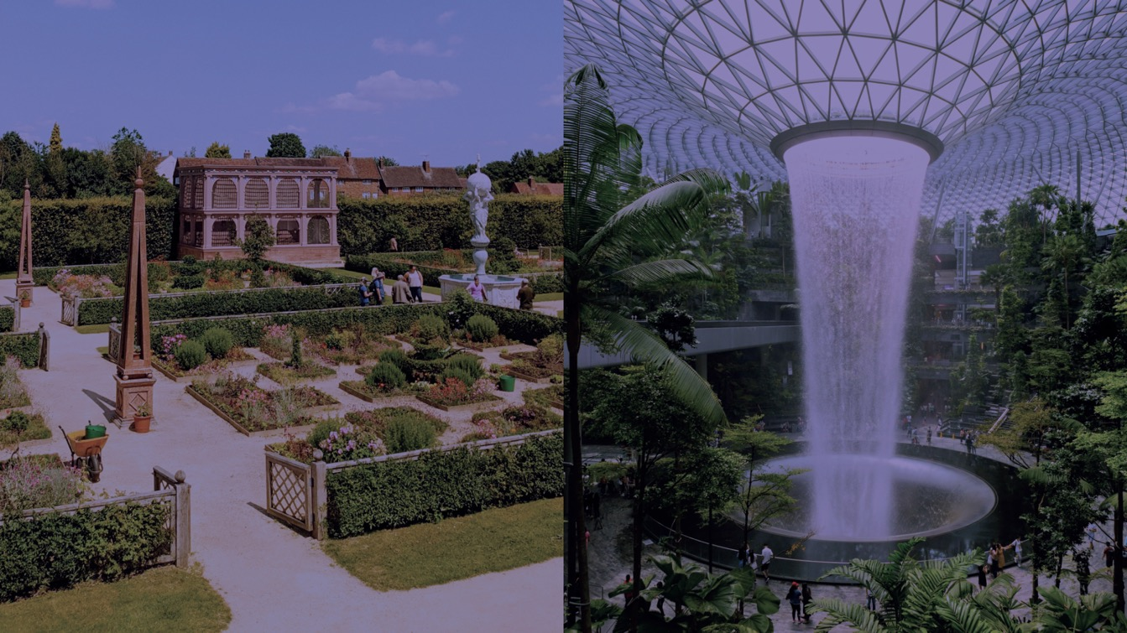
CHOOSE AN APPROACH

Slide 59
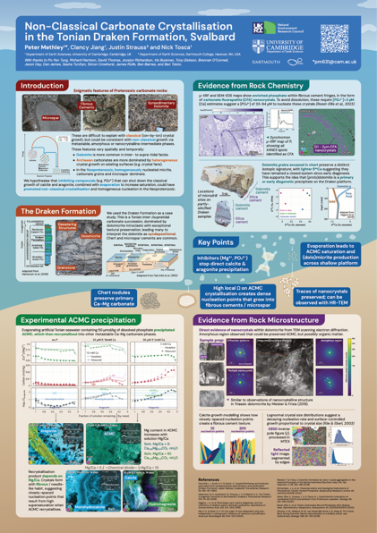
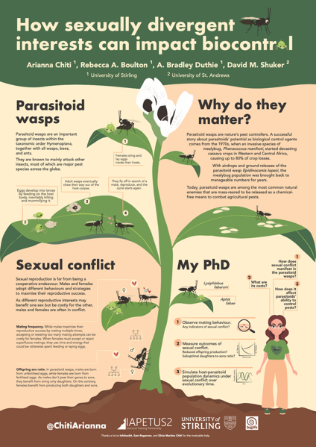

Slide 60
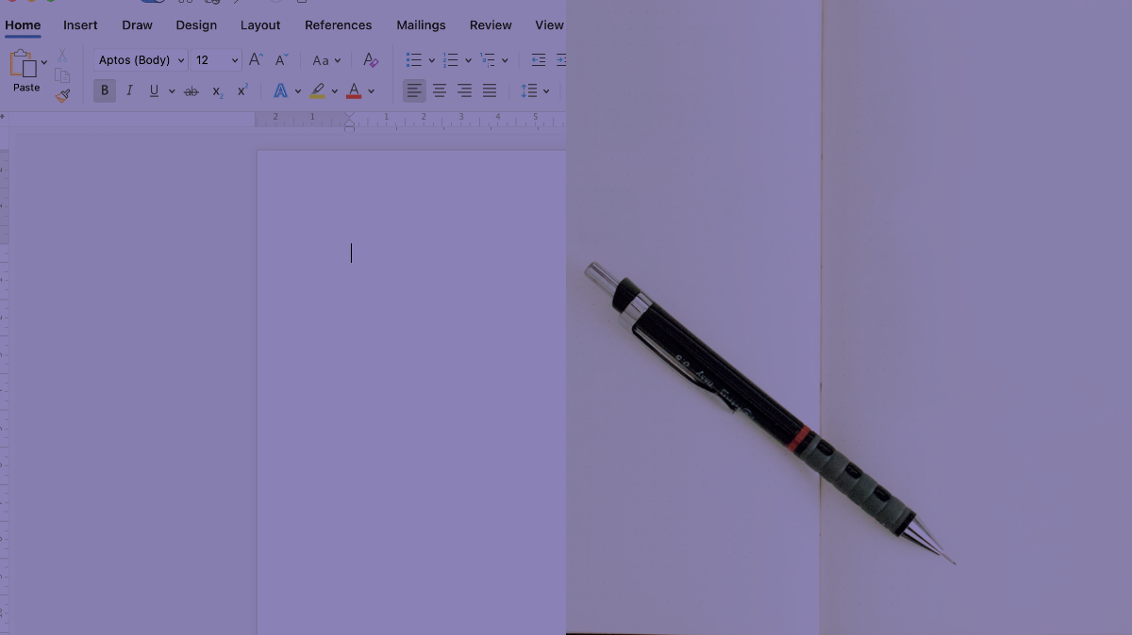
PLAN AND PROTOTYPE

Slide 61
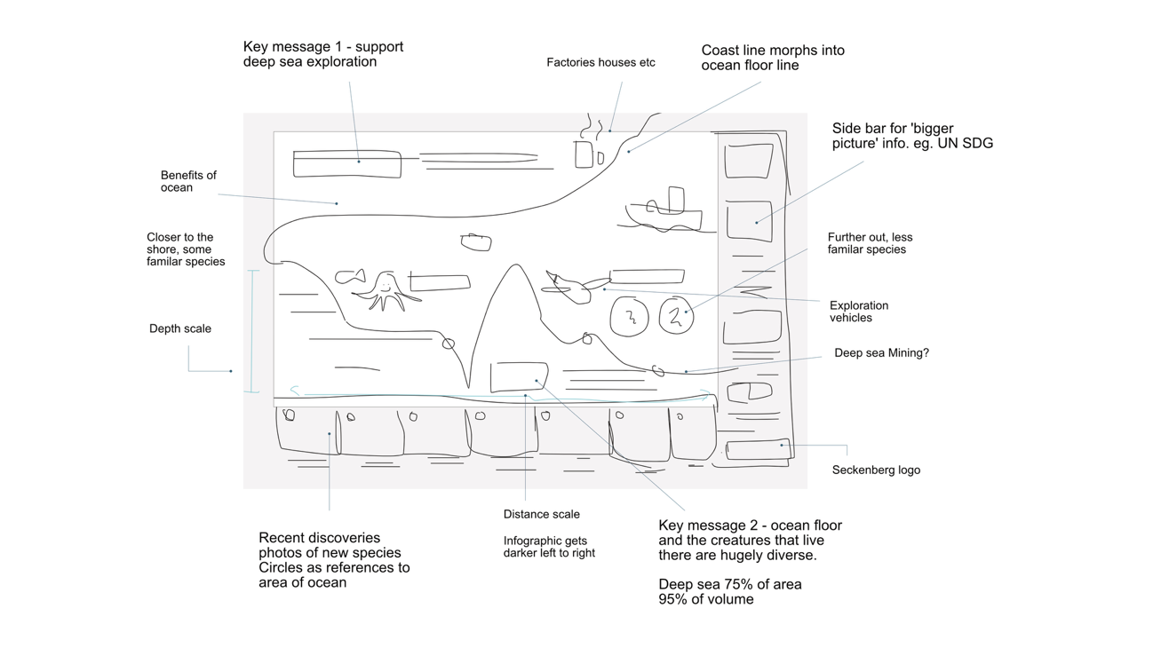

Slide 62
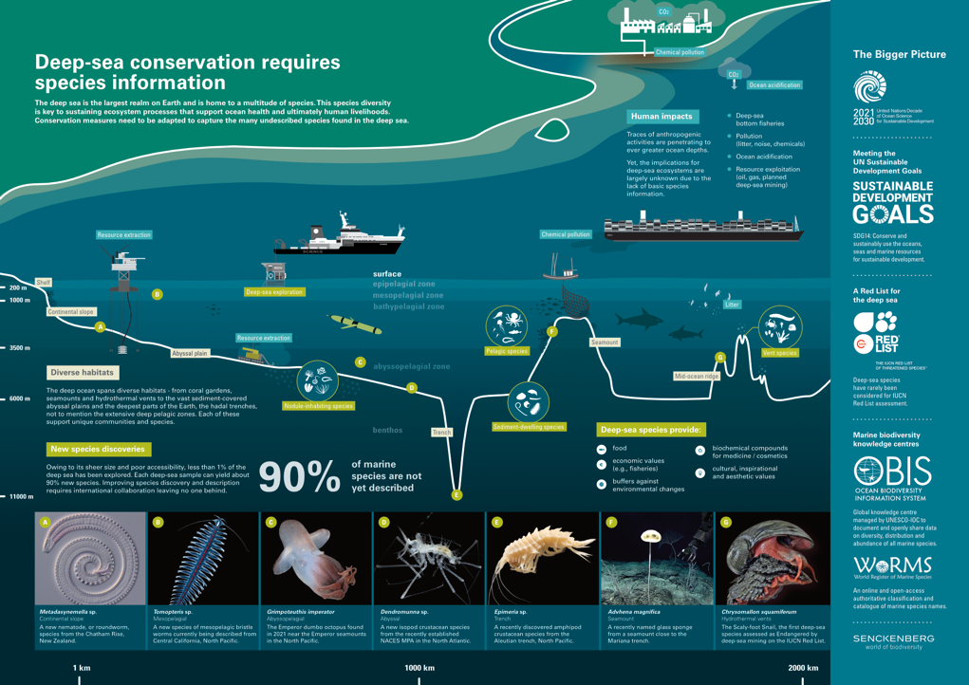

Slide 63





DESIGN TOOLS
GOOD VECTOR SOFTWARE
ALTERNATIVES
-
AFFINITY:
- Cheap licence
- No subs
- Easy to pickup
ADOBE ILLUSTRATOR:
- Subscription based
- Harder to learn
INKSCAPE:
- Free
- Harder to learn
- More widely used in academia
POWERPOINT:
- Most have access
- Has vector support
- Native RGB, can cause problems in print
CANVA ET AL:
- Freemium
- Reduces thought
eg. templates

Slide 64
M
G
P
MARGINS
GUTTERS
PADDING
MAKE
GREAT
PROJECTS

Slide 65

MGP
MARGINS
GUTTERS
PADDING
POSTER BY: HOLLIE BLAYDES

Slide 67


Slide 69
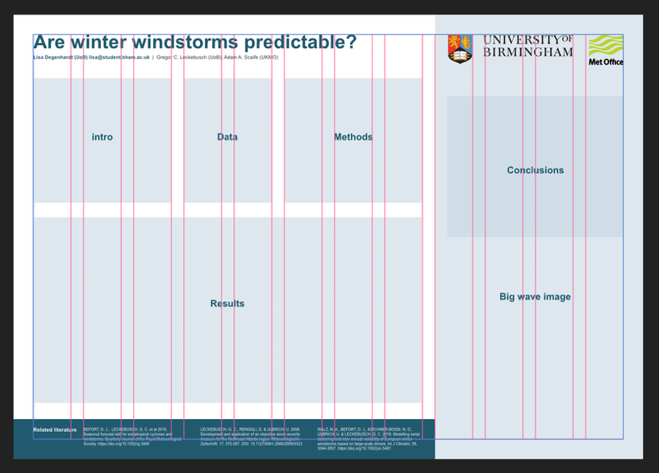

Slide 70
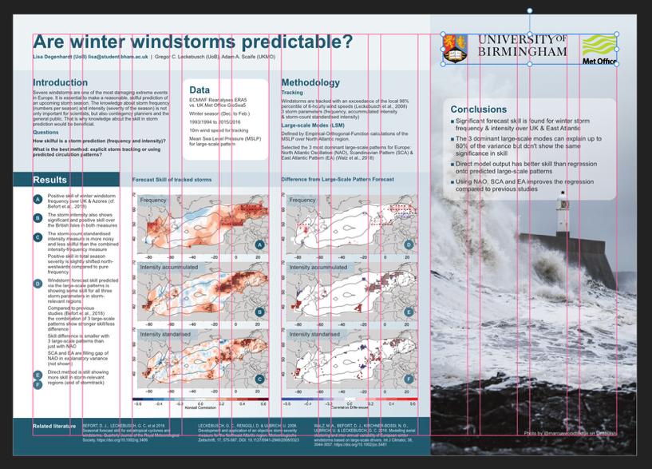

Slide 71


Slide 72
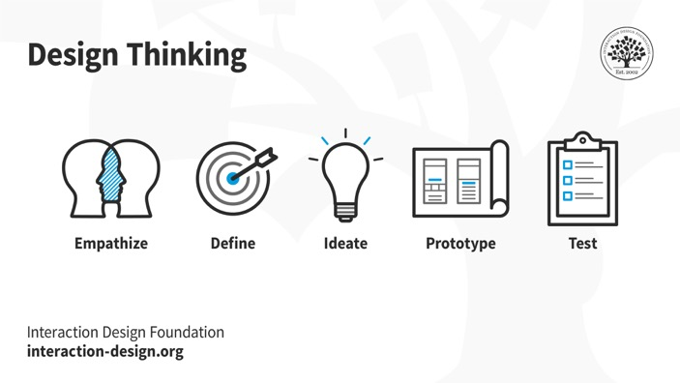
PERFECT PLANNING
EXERCISE:
PLAN AN INFOGRAPHIC PROJECT

Slide 73


QUICK
BREAK

Slide 74
PERFECT PLANNING
EXERCISE:
PLAN AN INFOGRAPHIC PROJECT

Slide 75
FRUIT
HOUSE
PLANT
ICE CREAM
§
PROBLEM
SOLVING
GRAPH
VIRUS
FAMILY

Slide 76
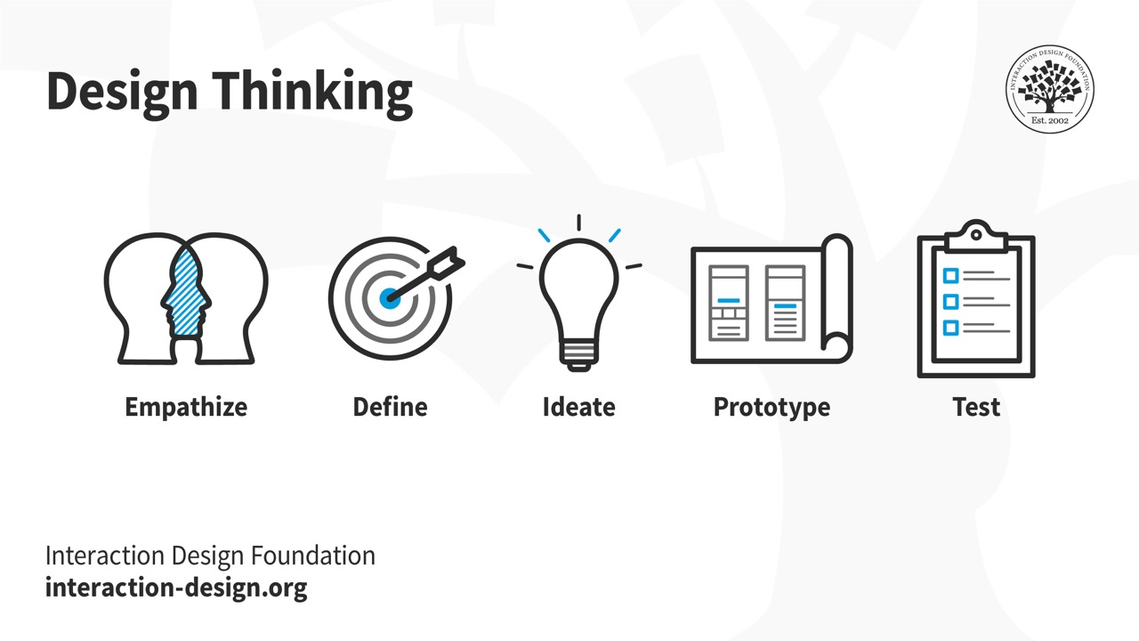

Slide 77

Planning and prototyping
1. Empathise
2m
Write down possible target audiences for your infographic

Slide 78
Planning and prototyping
2.1 Define
2m
Why does this audience need or want your information?

Slide 79
Planning and prototyping
2.2 Define
1m
What channels will you use to reach them?

Slide 80
Planning and prototyping
3.1 Ideate
2m
What are the 3 key messages
you would like to deliver to your target audience?

Slide 81
Planning and prototyping
3.2 Ideate
3m
What might help to visualize these concepts? Doodle objects and ideas.
Strictly NO COMPOSITION.

Slide 82
Planning and prototyping
4. Prototype
5m
Sketch a composition of your infographic.

Slide 83
FAREWELL FOR NOW
infohackit 12 month programme
£160
Software skills
Illustration
Typesetting
Composition
20 hours of training
+ mentoring
+ webinar series
+ Discord community
All delivered on Zoom

